Slide 1
Internet Protocol Security (IPsec) & Secure Sockets Layer (SSL)
INFSCI 1075: Network Security – Spring 2013
Amir Masoumzadeh

Slide 2
Review
Over the last few weeks
  Cryptography
  Authentication, Key Establishment
Main characteristics
  Security services are similar
    Need some entity authentication and key establishment
    Provide authentication, integrity and confidentiality
      Make use of message authentication codes and encryption

Slide 3
Application-Transparent Security
Questions
  Should all applications employ their own authentication, integrity, and confidentiality mechanisms?
  Can we make security transparent to applications?
  At what layer should such security services be implemented?
  Are there problems if we do take this approach?
SSL and IPsec are two common ways of providing the same security services to all applications

Slide 4
At What Layer Should We Implement Security Services?
Layers
  SSL/TLS is said to be implemented at layer 4
  IPSec is said to be implemented at layer 3
Implications
  Most OSs implement the IP stack up to layer 4 (including TCP)
  SSL’s philosophy is that the OS need not be changed
    Simply create a superset of the API to TCP
    Modifying applications to use SSL requires minimal effort
    Transport layer security is really above the transport layer
  IPsec’s philosophy
    If the OS implements security, all applications are automatically protected
    No applications need be modified

Slide 5
Layering Implications
If SSL is used
  TCP has no idea if a packet is malicious
  It may discard the real data if a malicious packet is inserted with the same sequence number
  Cannot be used with UDP
If IPsec is used
  Only IP addresses are used for security
    Although this isn’t simple address filtering!
  There is NO authentication of the user
    Application may still need to use a login/password to determine the user’s authenticity
  Faster than SSL and hardware implementation is easier
Applications
Applications
SSL
TCP
TCP
IP
IPSec
Lower Layers
IP
Lower Layers

Slide 6
IPsec - Network Layer Security
Encrypts and authenticates all traffic at the IP level
  Use on LANs, WANs, public, and private networks
Application independent
  Web browsing, telnet, FTP, etc.
Transparent to user
Provides the following security services at the IP level
  Access control
  Connectionless integrity
  Data origin authentication
  Rejection of replayed packets
  Data confidentiality
  Limited traffic analysis confidentiality

Slide 7
Cases where IPsec can be used
Internet/
Intranet
End-to-end security between two hosts
SG
Internet/
Intranet
SG
End-to-end security between two security gateways

Slide 8
Cases where IPsec can be used (cont.)
SG
Internet
SG
Intranet
Intranet
End-to-end security between two hosts + two gateways
Internet
SG
Intranet
End-to-end security between two hosts during dial-up

Slide 9
Protocols in IPsec
Authentication Header (AH)
  Ensures authentication and integrity of IP datagrams
  Adds an additional field to the IP packet to ensure and check the authenticity of data
  Uses sequence numbers to prevent/reject replayed datagrams
Encapsulating security payload (ESP)
  Primarily designed for confidentiality
  May also be employed for authentication
Internet Key Exchange (IKE)
  Exchanging keys between entities that need to communicate over the Internet
  What authentication methods to use, how long to use the keys, etc.

Slide 10
Security Association (SA)
Unidirectional relationship between a sender and a receiver
  Two security associations are required for bidirectional operation
Specifies the security services provided to the traffic carried on the SA
  Example: Integrity only, integrity + confidentiality, etc.
The SA is identified by three parameters
  IP Destination Address (unicast vs. multicast)
  Security Protocol Identifier
    Specifies whether AH or ESP is being used
  Security Parameters Index (SPI)
    Specifies the security parameters associated with the SA

Slide 11
Security Association (cont.)
Multiple security associations are used to provide required security services
  Such security associations are called SA bundles
  Example: we can have an AH protocol followed by ESP or vice versa
A Security Association specifies
  Mode of authentication in AH
  The ESP encryption algorithm and authentication algorithms
  Presence or absence of cryptographic synchronization
  How often the keys have to be changed
  Key lifetimes
  Lifetime of the SA

Slide 12
Transport Mode
IPsec specifies two modes of operation
  Transport mode
  Tunnel mode
In the transport mode, the IP headers are not completely protected
  Protection is provided for the upper layers
  Usually used in host-to-host communications
  IPsec header is inserted between the IP header and the rest of the packet
IP Header
Rest of the Packet
IP Header
IPSec Header
Rest of the Packet

Slide 13
Tunnel Mode
In the tunnel mode the original IP headers are completely protected
  Adds another IP header in the end (there is IP-in-IP tunneling)
  Helps against traffic analysis
  The original IP packet is untouched in the Internet
Commonly used for firewall to firewall communications or end-node to firewall communications
IP Header
Rest of the Packet
New IP Header
IPSec Header
IP Header
Rest of the Packet

Slide 14
Authentication Header (AH)
Provides
  Support for data integrity and authentication of IP packets
  Prevention of address spoofing and replay attacks
Does not provide confidentiality of payload data
Authentication is based on using a MAC
  Parties must share a secret key
Problem
  NAT is not supported and using AH implies that NAT needs to be removed

Slide 15
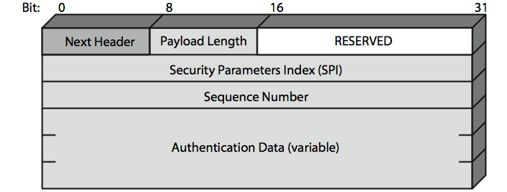
AH Details
Next header
  Identifies what protocol header follows
Payload length
  Indicates the number of 32-bit words in the authentication header
Security Parameters Index
  Specifies to the receiver the algorithms, type of keys, and lifetime of the keys used
Sequence number
  Counter that increases with each IP packet sent from the same host to the same destination and SA
Authentication Data
  The MAC associated with it
Notes:
• Next Header (8 bits): Identifies the type of header immediately following this header
• Payload Length (8 bits): Length of Authentication Header in 32-bit words, minus 2.
• Reserved (16 bits): For future use
• Security Parameters Index (32 bits): Identifies a security association
• Sequence Number (32 bits): A monotonically increasing counter value
• Authentication Data (variable): A variable-length field (must be an integral number of 32-bit words) that contains the Integrity Check Value (ICV), or MAC,for this packet

Slide 16
AH: Preventing Replay
Using 32 bit sequence numbers helps detect replay of IP packets
The sender initializes a sequence number for every SA at zero
  Each succeeding IP packet within a SA increments the sequence number
  The SA expires when 2³² packets are sent
Receiver implements a window size of W to keep track of authenticated packets
Receiver checks the MAC to see if the packet is authentic

Slide 17
AH: Transport Mode vs. Tunnel Mode
Transport mode:
  Provides protection primarily for upper-layer protocol payloads, by inserting the AH after the original IP header and before the IP payload
  Typically, transport mode is used for end-to-end communication between two hosts
Tunnel mode:
  Provides protection to the entire IP, after the AH or ESP fields are added to the IP packet, the entire packet plus security fields is treated as the payload of new “outer”IP packet with a new outer IP header
  Tunnel mode is used when one or both ends of an SA are a security gateway, such as a firewall or router that implements IPsec.

Slide 18
Transport Mode AH
Internet/
Intranet
Original IP
Header
TCP
Header
Payload Data
Without IPsec
Original IP
Header
Auth
Header
TCP
Header
Payload Data
Next
Header
Payload
Length
SPI
Seq.
No.
MAC

Slide 19
Transport Mode AH (cont.)
The MAC is calculated over
  IP header fields that do not change in transit
    These are called immutable fields
  The AH fields outside of the MAC itself
  Higher layer data
    TCP segment for example
The AH MAC is generated using HMAC (SHA or MD5)
  The MAC is truncated to 96 bits

Slide 20
Tunnel Mode AH
Internet
SG
Intranet
Original IP
Header
TCP
Header
Payload Data
Without IPsec
New IP
Header
Auth
Header
Original IP
Header
TCP
Header
Payload Data
Next
Header
Payload
Length
SPI
Seq.
No.
MAC

Slide 21
Tunnel Mode AH (cont.)
The entire original IP packet is authenticated
The AH is inserted between the original IP header and a new IP header
The original IP header contains the ultimate source and destination addresses
The new IP header may contain other IP addresses (like security gateway or firewall addresses)

Slide 22
Encapsulating Security Payload (ESP)
Creates
  A new header in addition to the IP header
  A new trailer
Services
  Encrypts the payload data
  Authenticates the security association
  Prevents replay

Slide 23
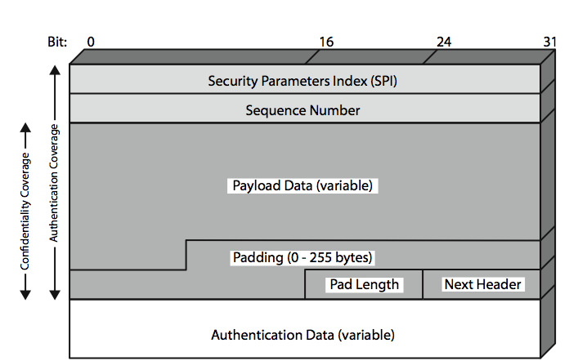
ESP Details
Security Parameters Index (SPI)
  Specifies to the receiver the algorithms, type of keys, and lifetime of the keys used
Sequence number
  Counter that increases with each IP packet sent from the same host to the same destination and SA
Payload
  Application data carried in the TCP segment
Padding
  0 to 255 bytes of data to enable encryption algorithms to operate properly
  To mislead sniffers from estimating the amount of data transmitted
Next header
Authentication Data
  MAC created over the packet
Notes:
• Security Parameters Index (32 bits): Identifies a security association
• Sequence Number (32 bits): A monotonically increasing counter value; this provides an anti-replay function ,as discussed for AH
• Payload Data (variable): This is a transport-level segment (transport mode) or IP packet (tunnel mode) that is protected by encryption
• Padding (0–255 bytes): for various reasons
• Pad Length (8 bits): Indicates the number of pad bytes immediately preceding this field
• Next Header (8 bits): Identifies the type of data contained in the payload data field by identifying the first header in that payload
• Authentication Data (variable): A variable-length field that contains the Integrity Check Value computed over the ESP packet minus the Authentication Data field

Slide 24
ESP: Transport Mode vs. Tunnel Mode
Transport mode is used to encrypt & optionally authenticate IP data
  Data protected but header left in clear
  Can do traffic analysis but is efficient
  Good for ESP host to host traffic
Tunnel mode encrypts entire IP packet
  Add new header for next hop
  Good for VPNs, gateway to gateway security

Slide 25
Transport Mode ESP
Original IP
Header
TCP
Header
Payload Data
Without IPsec
Original IP
Header
ESP
Header
TCP
Header
Payload Data
ESP
Trailer
ESP
Auth
Encrypted
Authenticated
SPI
Seq.
No.
TCP H
Data
Padding
Pad
Length
Next
Header
MAC
Encrypted
Authenticated

Slide 26
Transport Mode ESP (cont.)
The block of data containing the ESP trailer and the transport layer segment is converted to ciphertext
Authentication is optional
  If selected, authentication covers the ciphertext and the ESP header only
  Authentication does not cover the IP header

Slide 27
Encryption and Authentication Algorithms for ESP
IPsec specifies that DES must be supported (mandatory)
In addition, the following encryption algorithms might be used
  3DES, IDEA, Blowfish, CAST, and RC5
For message authentication
  HMAC with MD5 or SHA
  Truncate the output to 96 bits

Slide 28
Tunnel Mode ESP
Original IP
Header
TCP
Header
Payload Data
Without IPSec
New IP
Header
ESP
Header
Original IP
Header
TCP
Header
Payload Data
ESP
Trailer
ESP
Auth
Encrypted
Authenticated

Slide 29
Tunnel Mode ESP (cont.)
The entire IP packet is encrypted
  Can counter traffic analysis
The entire encrypted block is encapsulated in another IP packet and transmitted
  This could be done by a firewall or a security gateway
Useful if hosts within an Intranet are incapable of IPsec

Slide 30
Combining Security Associations
A single SA can specify either AH or ESP but not both
In order to provide security services, we need to use multiple security associations
A sequence of security associations executed in order on an IP packet is referred to as a security association bundle
The SAs within a SA bundle may terminate at the same endpoints or different endpoints

Slide 31
Security Association Bundles
Transport adjacency
  Use more than one IPsec protocol without tunneling
  Example: ESP followed by AH
  Usually performed at the same end-points
Iterated tunneling
  Multiple IPsec protocols used with IP tunneling
  Each tunnel can originate or end at different hosts along the route

Slide 32
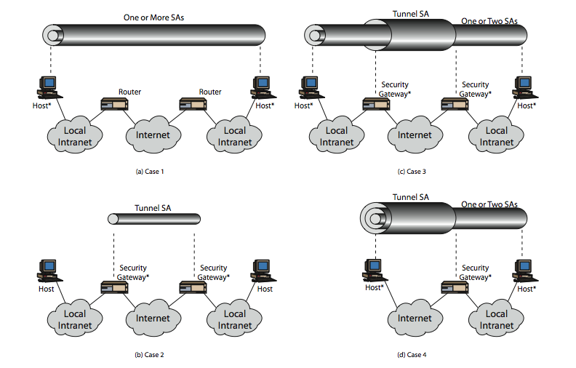
Security Association Bundles: Examples

Slide 33
Internet Key Exchange (IKE)
Idea: a protocol for
  Agreement on which protocols, algorithms, and keys to use – negotiation services
  Ensuring from the beginning that you are talking with an entity that you believe you are talking with – primary authentication services
  Managing keys after they have been agreed upon – key management
  Exchanging material for generating the keys safely
Reality:
  Confusing and chaotic - ISAKMP, IKE, Oakley…
  Took almost 10 years to formulate and it is still too complex

Slide 34
Secure Sockets Layer (SSL)
Provides transport layer security to any TCP-based application.
  e.g., between Web browsers, servers for e-commerce (shttp)
Security services:
  Server authentication, data encryption, message integrity, client authentication (optional)
Application
Application
SSL sublayer
SSL
socket
TCP
socket
TCP
TCP
IP
IP
TCP API
TCP enhanced with SSL

Slide 35
SSL (cont.)
Open protocol designed by Netscape
  SSLv2 was the first deployed version
  Microsoft created its own protocol called PCT (Private Communications Technology)
  Netscape overhauled SSLv2 and created SSLv3
Version 3 used public input and industry backing
SSL subsequently became Internet standard known as TLS (Transport Layer Security)
Uses TCP to provide a reliable end-to-end service

Slide 36
SSL: Simplified Protocol
SSL
Client
SSL
Server
(1) Connect to server and request authentication of server
(2) Prove identity by sending a digital certificate
(3) (Optional) Request authentication of client
(4) Negotiate something like a security association
(5) Generate Session keys at both client and server

Slide 37
SSL: Simplified Protocol (More Details)
SSL
Client
SSL
Server
I want to connect, Ciphers I support, R_{client}
My certificate, Ciphers I choose, R_{server}
Select a secret S
Compute key K
K = f(S, R_{client}, R_{server})
E_{KU-Server}[S] || Keyed Hash of Handshake Messages
Compute key K
K = f(S, R_{client}, R_{server})
Keyed Hash of Handshake Messages
S = Premaster Secret
K = Master Secret
Protected Data Exchange

Slide 38


SSL: Phase 1 – Handshake
Bob establishes TCP connection to Alice
Authenticates Alice via CA signed certificate
Creates, encrypts (using Alice’s public key), sends master secret key to Alice
  nonce exchange not shown
TCP SYN
TCP SYNACK
TCP ACK
SSL hello
certificate
create
Master
Secret
(MS)
K_{A}⁺(MS)
decrypt using K_{A}⁻
to get MS

Slide 39
SSL: Phase 2 – Key Derivation
Alice and Bob use shared secret (MS) to generate 4 keys:
  E_{BA}: Bob->Alice data encryption key
  E_{AB}: Alice->Bob data encryption key
  M_{BA}: Bob->Alice MAC key
  M_{AB}: Alice->Bob MAC key
Encryption and MAC algorithms negotiable between Bob and Alice
Why 4 keys?
  One key for A -> B confidentiality
  One for A -> B authentication/integrity

Slide 40
SSL: Phase 3 – Data Transfer
TCP byte stream
b₁b₂b₃ … b_{n}
block n bytes together
d
M_{AB}
.
compute MAC
H( )
d
H(d)
E_{AB}
.
H( )
encrypt d, MAC, SSL seq. #
SSL
seq. #
d
H(d)
SSL record
format
Type Ver Len
d
H(d)
unencrypted
encrypted using E_{AB}

Slide 41
SSL Connections and Sessions
SSL Connection
  A transport that provides a suitable type of service
  Peer-to-peer relationship
  Short-lived TCP connections per web page or object on web page
  Associated with a session
SSL Session
  Created by the handshake protocol
  Specify a set of cryptographic parameters for the session (like a SA)
  These parameters are used for each connection within the session
  Association between a client and a server
    Server stores a session ID and the associated master secret
    If client presents a session ID that the server remembers, they can skip the public key portion of the handshake protocol

Slide 42
SSL Architecture
SSL implements the initial steps in the simplified protocol using what is known as the “SSL Handshake Protocol”
  Establish security capabilities and authenticate server using a certificate
In addition, SSL specifies three other protocols:
  SSL Record protocol
    Handles all SSL communications
    Carries the encrypted data with integrity protection
    Also carries the other SSL protocols within it
  SSL Change Cipher Spec Protocol
    Indicate completion of handshake
    Allow changes to cipher suites used if necessary
  SSL Alert Protocol
    Indicate errors or terminate a session

Slide 43
SSL Architecture (cont.)
Standard HTTP uses TCP Port 80 by default
SSL uses TCP Port 443 by default
SSL Handshake
Protocol
SSL Change
Cipher Spec
Protocol
SSL Alert
Protocol
HTTP
SSL Record
Protocol
TCP
IP

Slide 44
SSL Record Protocol
Provides basic security services to various higher layer protocols
  Used to exchange higher layer data especially HTTP as well as the data of various SSL protocols
  Record type specifies what is being carried by the record protocol
  Also fragments and reassembles application data
  Provides compression (optional)
Provides two services for each SSL Connection
  Confidentiality
    Uses the shared secret encryption key for encryption
  Message authentication
    Uses the shared secret integrity key to create a MAC

Slide 45
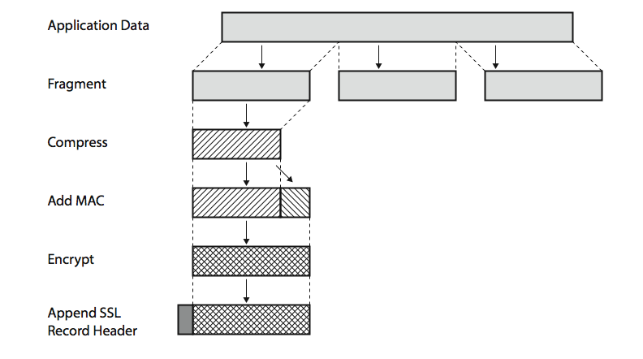
SSL Record Protocol – Operation

Slide 46
SSL Change Cipher Spec Protocol
Simplest SSL Protocol (Record type=20)
Has a single byte with the value 1
Completes the handshake protocol
Sets the security parameters for the rest of the connection or session
  “Copy pending state to current state”
  Says “From this point onwards, all records that are received will be protected using these agreed upon ciphers and keys”

Slide 47
SSL Alert Protocol
Used to indicate errors or used to terminate a session (Record type=21)
Alert messages are compressed and encrypted
Messages consist of two bytes
  First byte is “fatal” or “warning”
  Second byte specifies the alert
Some alert examples:
  Fatal
    bad_record_mac
    handshake_failure
  Warnings
    no_certificate – client does not have one
    close_notify
If the level is fatal, the SSL terminates the connection

Slide 48
SSL Handshake Protocol
Most complex of the SSL protocols
  Record type = 22
Allows the server and client to authenticate each other and negotiate an encryption algorithm/keys
Each message has three fields
  Type: One of ten messages
  Length
  Content: Parameters associated with a type, etc.
Example: client_hello (type = 1) has parameters version, random, session id, cipher suite, compression method
Example: certificate_verify (type = 15) has a parameter signature

Slide 49
SSL Handshake Protocol – Phase I
Establish security capabilities
Initiated by the client
  Send a client_hello message
  Specify highest version of SSL that can be understood by the client
  A nonce consisting of a time stamp and a random number concatenated
  List of cryptographic algorithms in decreasing order of preference
Response from the server with a server_hello message with roughly the same parameters
  Server specifies the selected cipher suite instead of a sequence of cipher suites
  Server may send a session-id for use by client to resume session
  Key exchange mechanism, MAC and hash sizes, initial vector for CBC mode, etc., are agreed upon

Slide 50
SSL Handshake Protocol – Phase II
Server Authentication and Key Exchange
  Server sends its digital certificate
  X.509 certificates are used
    Uses a message called “certificate” (type = 11) and one or more certificates as the parameters
  Diffie-Hellman or RSA may be used
  A signature only key is possible
    This is for export reasons
    In this case, the server will send an ephemeral shorter public key signed with its long-term private key
    For this, a “server_key_exchange” message (type = 12) is used
Concluded with a “server_hello_done” message (zero length)
  This has type = 14
  It has no parameters

Slide 51
SSL Handshake Protocol – Phase III
Client authentication and key exchange
  Client checks the server certificate and validates it
  If the server requests a client certificate, the client either sends a certificate or replies with “no_certificate”
    Server can use the “certificate_request” message (type = 13)
    Client Authentication is optional
    The client may ask the server to verify its certificate if it had sent one (“certificate_verify” - type = 15) by signing a hash of all the previous messages
Client sends a 48-byte “pre-master-secret” encrypted with the public key of the server if RSA is being used
  Only 46 bytes are random
  For this, the “client_key_exchange” message is used (type = 16)
  If Diffie-Hellman is being used, the DH parameters are transmitted

Slide 52
SSL Handshake Protocol – Phase IV
Finishing the handshake protocol
  Client and server need to know that the handshake is complete
Steps
  The client sends a “change_cipher_spec” message and copies the pending cipher specification state to the current state
  It sends a “finished” message (type = 20) using the parameters of the new cipher specification
  Server repeats this process as well
  This verifies that the key exchange and authentication process were successful

Slide 53
SSL Handshake: Remarks
The handshake protocol usually creates an SSL session
  Each session can have multiple connections
  Sessions avoid unnecessary and expensive negotiation of security parameters for each connection
  Each session has a pending state and a current operating state
The handshake protocol followed by the cipher spec change protocol makes the pending state the current state
  The old current state is deleted
The initial current state is always one with no encryption, no MAC and no compression

Slide 54
TLS (Transport Layer Security)
Specified in RFC 2246 (January 1999)
  Makes use of HMAC and not HMAC-like message authentication
  Has more alert messages than SSLv3
  Uses a pseudorandom function (PRF) based on HMAC to create keys
TLS messages are used within EAP for WLAN authentication and key exchange
WTLS is a variant of TLS that is used in the wireless application protocol (WAP)

